Slide 1
Analyzing Paradigm Shift - Taking a Leaf out of the Swiss Watch making experience

Slide 2
Lets go back to the 1950’s

Slide 3
Swiss People were known to be the Best Watch Makers in the World – The Mechanical Model

Slide 4
Understandably, a Swiss lady discovered the principle of using Quartz as a Technology improvement measure (This ultimately led to the “Quartz Revolution” in watch making)

Slide 5
However, the Swiss People did not accept the Ladies Suggestion . She was Banished from the Swiss Cantons . She in turn, went to Japan and the Japanese accepted her Suggestion … Rest is all History…!

Slide 6
As a Result, The Japanese became the Pioneers in Quartz Based Automation Revolution in Watch Making.

Slide 7
Why Did the Swiss do What they Did ?

Slide 8
Probably, carried the baggage of being the best watch makers in the world… as such, had a natural resistance to accept someone else’s suggestion … moreover from a Lady (Remember, the Swiss women got their right to vote only in early 1970’s …!!!)

Slide 9
They must have thought that being the Best in this Domain, How could anybody Teach them ?

Slide 10
As such they Continued to Follow their Time Tested Ways

Slide 11
What the Swiss Did, Was Even Surprising …

Slide 12
They Remained Blinded to the utility of “Quartz” as an Improvement in watch making over the Mechanical Model Perfected by them from ages

Slide 13
In fact , Perturbed by the Lady’s Suggestion, to make their Watches “Look ” (?) Better they Studied there Watches with Gold, Silver and Platinum. In Turn, While the Watches did Become Better looking “Aesthetically” , they Became Extremely Expensive Instead. All this with no “Qualitative” Improvement

Slide 14
As a Result, the Watches Became More Expensive …
A Preserve of the Rich alone and as something to be kept in a Museum for its Aesthetic Qualities

Slide 15
What they Forgot was that the Purpose of Improving the Watch should be to tell time More Accurately rather than to Look More Beautiful – Clearly an example of Goal Shifting and that too without being even Aware of it

Slide 16
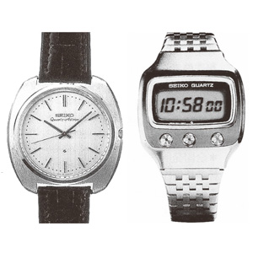
Let us Now Look at the Context of 1950’s Post 2nd World War Era

Slide 17
Post 2nd World War Scenario

Slide 18
Less Expensive, Mass Based Goods the Requirement of the Times

Slide 19
Concept/Measure of Time was Changing with the Computers Coming in – Nano Seconds/ Mini-Micro Seconds which anyways, a Mechanical Watch could not have Measured

Slide 20
As such, Commercially as also Technologically, What the Swiss did was Absolutely Counter Intuitive… but Still they did what they did and Ignored what was Written Clearly on the Wall

Slide 21
Why Did The Japanese Do What They Did ?

Slide 22
No Baggage, Hence No Burden of Legacy/ Reputation to Live up to …
They, with an open mind , being available at the periphery (away from the core), could adapt a “New and Cost Effective Technology” dictated by the need(Functional basis decision making) of the hour without Inhibition as long as it fulfilled the requisite purpose of the watch to providing time more accurately than what a mechanical watch could have provided

Slide 23
Explaining

Slide 24
Paradigm – is a Structure/ Frame of Reference of Things as We Have Seen Them to Be

Slide 25
To the Swiss, the Paradigm of a Watch was Big … Hands/Pendulums/Springs and Being Blinded by this Concept/Paradigm of a Watch in their Mind, they could not see the Utility of Quartz as a Watch Making Principle which Would Fit in their Existing Fold of Knowledge

Slide 26
Imprisoned by their Mental Paradigm of a Watch ( the only way it could be), They Could not think Beyond as they were Operating From the “Core” of Watch Making Industry Rather than Being Available also on the Periphery of their Contextual Surroundings of a World, that was Changing Beyond Watch Making
?
?
?
?

Slide 27
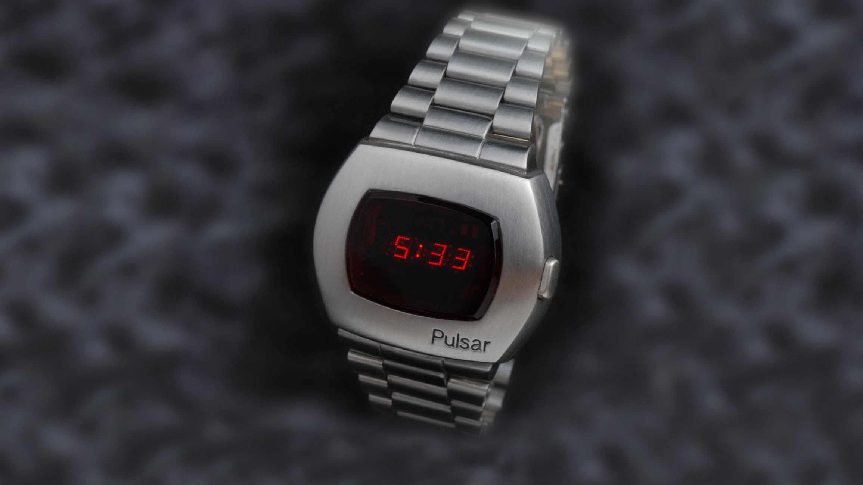
What Is The Paradigm That Was Shifting As We See It Today ?

Slide 28
Given the Paradigm (Frame/Shape/Look) of the Watch
(As is True Even Today in Several Walls Clocks)
We Would “See” Time

Slide 29
In the Digital Watches of Today, We Instead,
“Read Time”

Slide 30
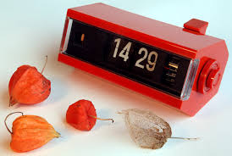
Hence the Paradigm of Reading Time from Seeing Time in the Mechanical Watches was something which the Swiss found difficult to Comprehend given their Mental Frame – Loaded with Baggage

Slide 31
Paradigm Shift is Hence Understood to be a Non Linear Change(From Seeing to Reading Time) which Requires Creativity, Parallel Thinking/ Design Thinking in our Approach to even Conceptualize, Leave Aside Actualized . Most often than not, the shift may be non Recognizable from its earlier Version and may be even not Connected to it - still be more Efficacious- it could be a Thing/Notion or an Idea

Slide 32
In a Technologically Disruptive World of Today, Where Linear Extrapolation is Dead, Paradigm is the order of the day to Handle to the Emerging VUCA World

Slide 33
PS Note :
The Swiss However Adopted the new Technology in Late 80’s and with their Being Really Good at Watch Making, they Regained their No 1 Position in Watch Making but Clearly lost out the Initial 30 years to Japan as the Leading Watch Maker

Slide 34
Fields of Listening –
a Tool to Remaining Agile Prepared to Capture Dynamic and Changing Future Possibilities:
Downloading
Empathic
Generative and
Expansive listening

Slide 35
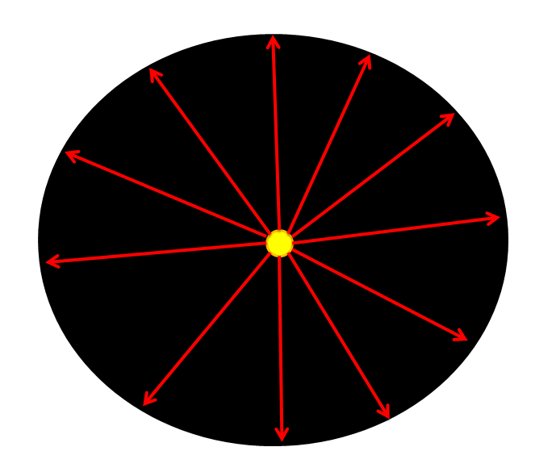

Slide 36
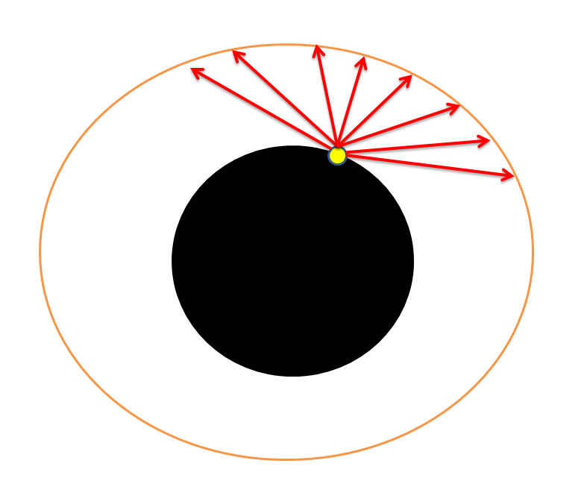

Slide 37
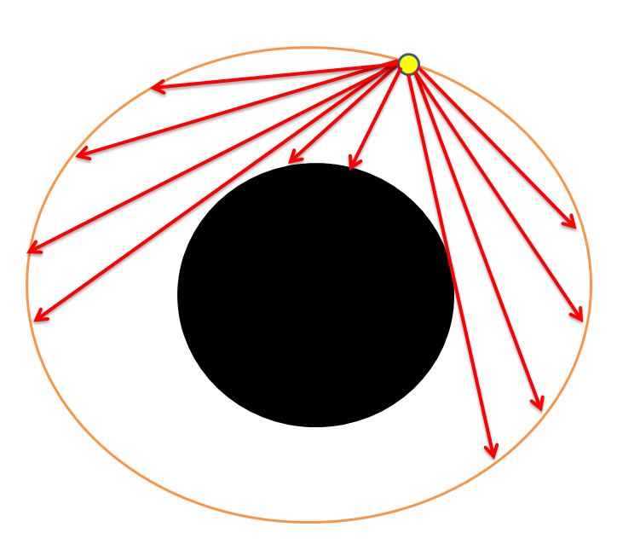

Slide 38
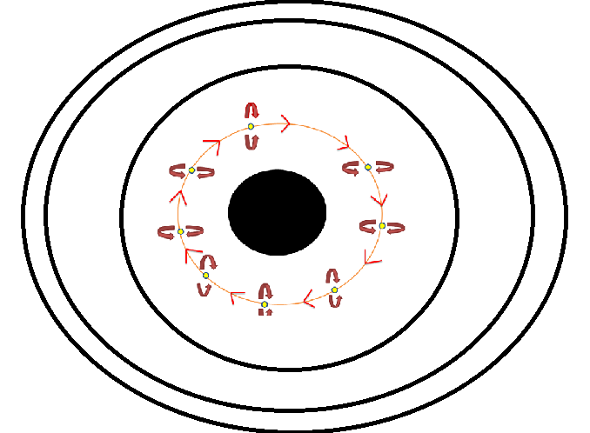

Slide 39
